Slide 1
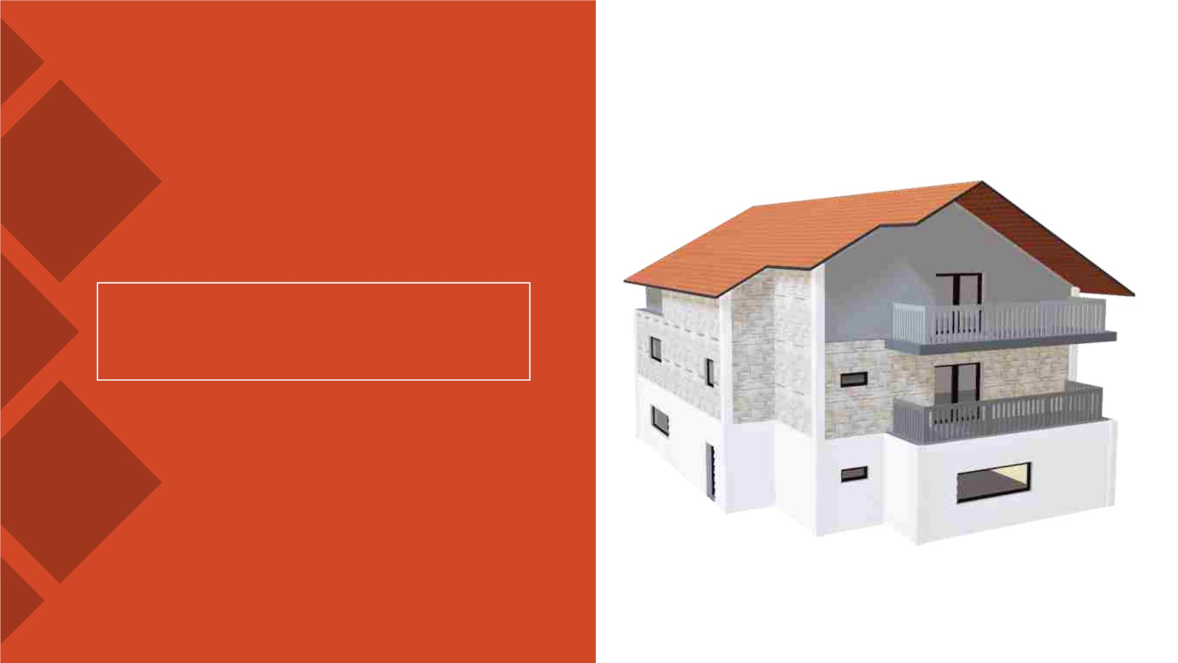
surprise Housing price
prediction project
A case study from US-based housing
company named “Surprise Housing”. The
company is looking at prospective
properties to buy houses at a price below
their actual values and flip them at a
higher price which will help the company
to enter the real estate market.
PRESENTATION
Submitted by Chenthamizh Arasu
Data Science Intern
Flip Robo Technologies

Slide 2

ACKNOWLEDGMENT
§ I would like to express my deepest gratitude to my SME
(Subject Matter Expert) Khushboo Garg as well as Flip Robo
Technologies who gave me the opportunity to do this project
on Surprise Housing Price Prediction, which also helped me in
doing lots of research wherein I came to know about so many
new things.
§ Also, I have utilized a few external resources that helped me
to complete the project. I ensured that I learn from the
samples and modify things according to my project
requirement.

Slide 3

HOUSING SALE PRICE PREDICTION PROJECT

Slide 4
INTRODUCTION
§ Surprise Housing is a US based Real estate and housing
company who is trying to entry into Australian Real estate
market. The company is looking at prospective properties to
buy houses to enter the market. We are required to build a
model using Machine Learning in order to predict the actual
value of the prospective properties and decide whether to
invest in them or not.
§ For this Surprise Housing wants to know:
1. Which variables are important to predict the sale price of house?
2. How do these feature variables describe the price of the house?

Slide 5

AGENDA
§ Analytical Problem Framing
I. Exploratory Data Analysis (EDA)
II. Visualizations
§ Data Pre-Processing on train and test datasets
§ Model/s Development and Evaluation
§ Performing hyper parameter tuning, saving the
best model and predicting the label
§ Conclusion and future work discussion

Slide 6

Hardware - Software Requirements and
Tools Used
Hardware Used:
ü RAM: 8 GB
ü CPU: AMD Ryzen 5 3550H with Radeon Vega Mobile Gfx
2.10 GHz
ü GPU: AMD Radeon ™ Vega 8 Graphics and NVIDIA
GeForce GTX 1650 Ti

Slide 7

Hardware - Software Requirements and
Tools Used
Software Used:
ü Programming language: Python
ü Distribution: Anaconda Navigator
ü Browser based language shell: Jupyter Notebook
Libraries/Packages Used:
Pandas, NumPy, matplotlib, seaborn, scikit-learn and
pandas_profiling

Slide 8
PROBLEM STATEMENT
§ Houses are one of the necessary need of each and every person
around the globe and therefore housing and real estate market is
one of the markets which is one of the major contributors in the
world’s economy. It is a very large market and there are various
companies working in the domain.
§ Data science comes as a very important tool to solve problems in
the domain to help the companies increase their overall revenue,
profits, improving their marketing strategies and focusing on
changing trends in house sales and purchases.
§ Predictive modelling, Market mix modelling, recommendation
systems are some of the machine learning techniques used for
achieving the business goals for housing companies. Our problem
is related to one such housing company.

Slide 9
ANALYTICAL PROBLEM FRAMING
§ As we are provided with two sets of data, one is for training
and other for testing. Here we need to build a machine
learning model using train dataset and then by using that
model we will make predictions for test dataset.
§ Both the datasets are in csv format, train dataset has 1168
rows and 81 columns whereas test dataset has 292 rows and
80 columns. Here in the test dataset we do not have the
target label and need to predict the same.
§ And as we have to predict house sale prices in this problem
which is a continuous data, I will be using different regression
machine learning models.

Slide 10

DATA ANALYSIS - MODEL BUILDING
FLOWCHART
Import
Dependencies or
Libraries
Data set
Collection
Data
preprocessing
EDA and
Visualization
Checked for
Null Values
Encoding
Checked for
correlation
Checked for
Outliers/Skewness
Proceed for
Model building
Saving the
Final_Model
Hyper Parameter
Tuning
R2 Score, Cross
Validation Score,
MSE, RMSE, MAE

Slide 11
DATA PRE PROCESSING
üImporting the necessary dependencies and libraries.
üReading the CSV file and converted into data frame.
üChecking the data dimensions for the original dataset.
üLooking for null values and accordingly fill the missing data.
üChecking the summary of the dataset.
üChecking unique values.
üChecking all the categorical columns in the dataset.
üVisualizing each features using matplotlib and seaborn.

Slide 12
DATA PRE PROCESSING
üPerforming encoding using the ordinal encoder on
categorical features.
üChecking for co-relation/multi-collinearity in a heatmap.
üChecking for Outliers/Skewness using boxen plot and
distribution plot.
üPerform Scaling using Standard Scaler method.
üChecking for the final dimension of dataset to confirm the
input details.
üCreating train test split and the best random state found in
the range 1-1000.

Slide 13
EXPLORATORY DATA ANALYSIS (EDA) AND
VISUALIZATION
01. Univariate Analysis
02. Multivariate Analysis
03. Correlation of Dataset
Univariate analysisꢀis
the simplest form of
analyzing data. “Uni”
means “one”, so in
other words your data
has only one variable.
Multivariate analysisꢀis a
set of statistical
techniques used
forꢀanalysisꢀof data that
contain more than one
variable.ꢀ
Correlationꢀis used to
test relationships
between quantitative
variables or categorical
variables.
04. Correlation with Target variable
05. Conclusion
Correlationꢀwith the target
variable to know how the data is
related.
Summary with the
conclusion of all the
analysis

Slide 14
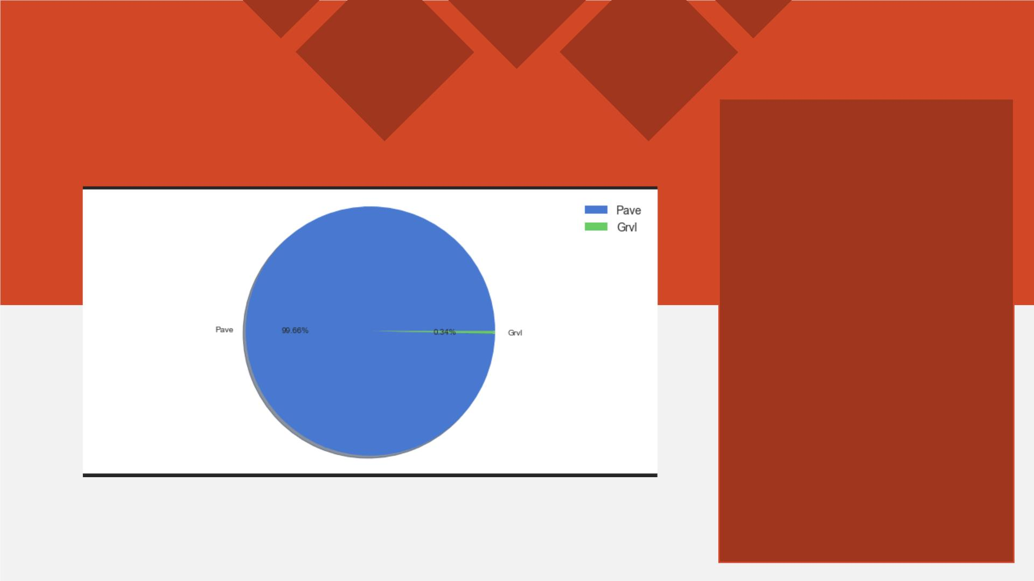
PIE PLOT
A Pie Chart is a circular
statistical plot that can
display only one series of
data.
The area of the chart is
the total percentage of
the given data.
The area of slices of the
pie represents the
percentage of the parts
of the data.

Slide 15
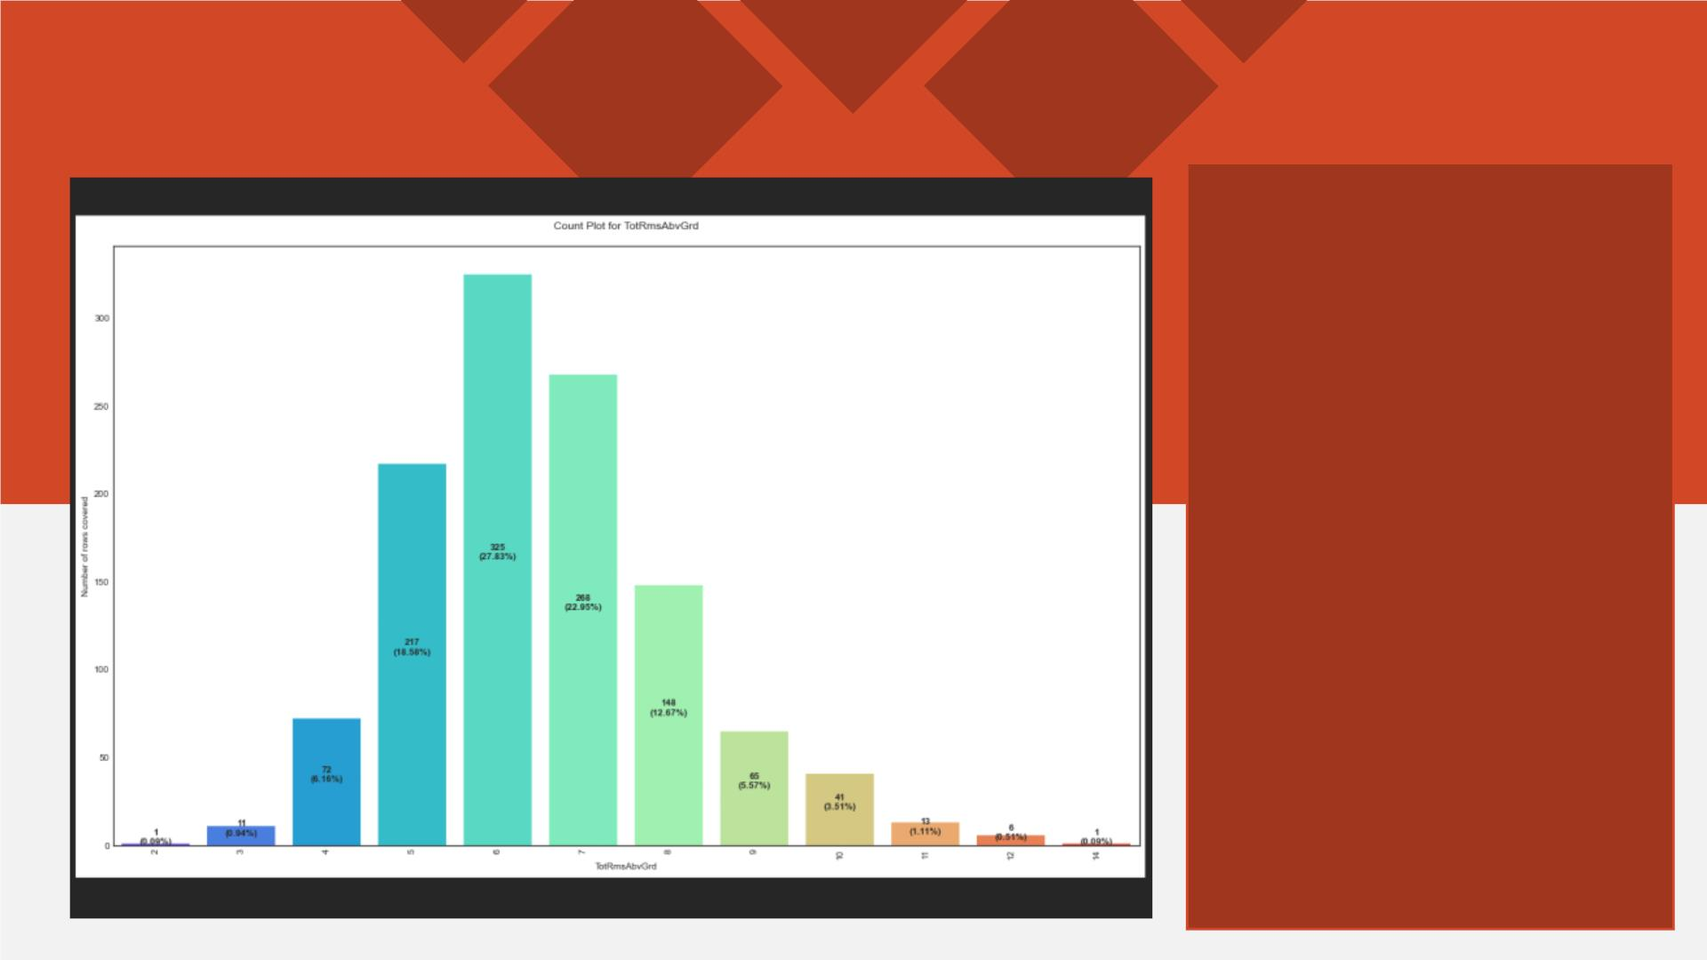
COUNT PLOT
Count plot method is
used to show the counts
of observations in each
categorical bin using
bars.
Parameters : This
method is accepting the
following parameters
that are described
below: x, y
This parameter take
names of variables in
data or vector data,
optional inputs for
plotting long-form data.

Slide 16
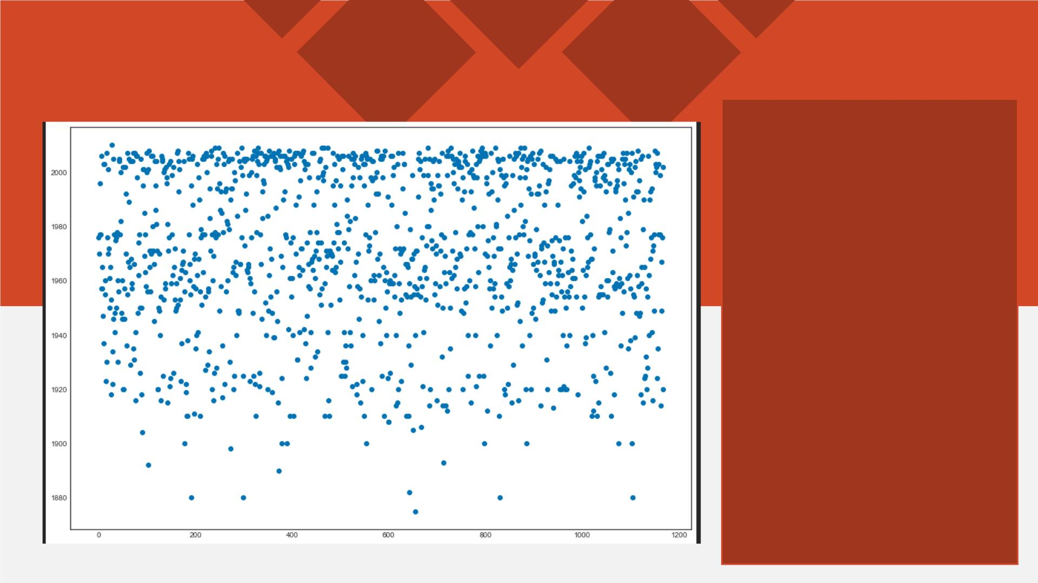
SCATTER PLOT
Scatter plots are used to
observe relationship
between variables and
uses dots to represent
the relationship
between them.
The scatter method in
the matplotlib library is
used to draw a scatter
plot.
Scatter plots are widely
used to represent
relation among
variables and how
change in one affects
the other.

Slide 17
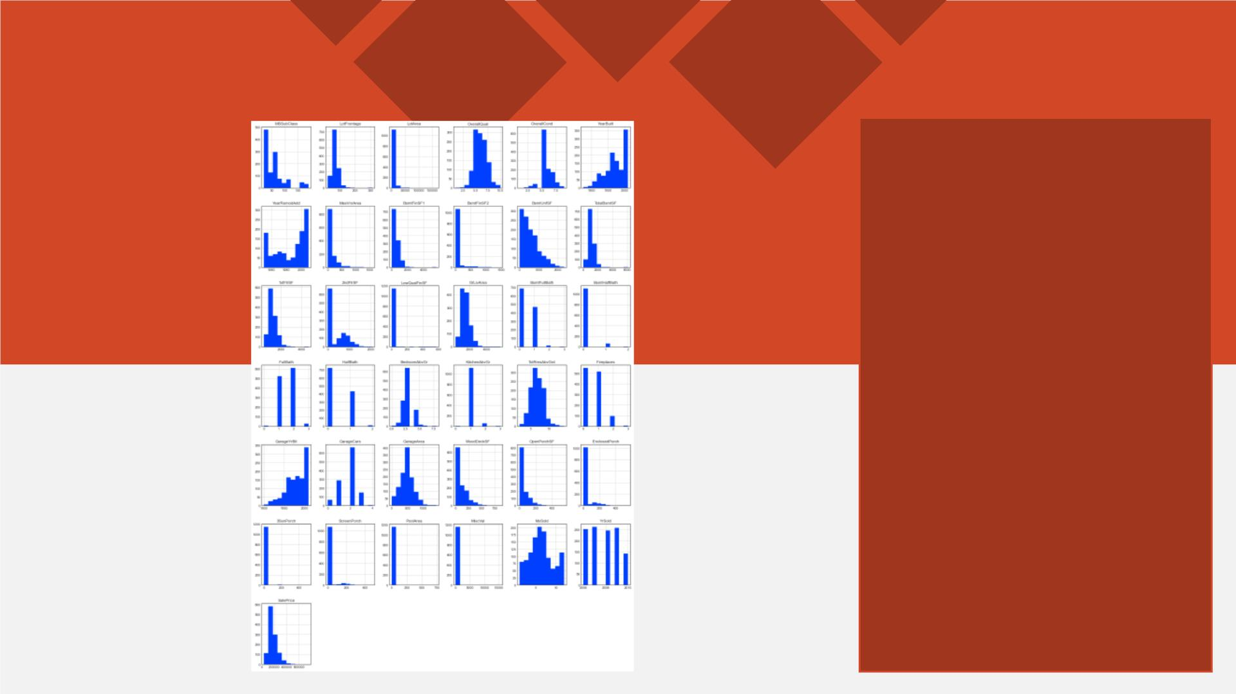
HISTOGRAM
A histogram is basically
used to represent data
provided in the form of
some groups.
It is accurate method for
the graphical
representation of
numerical data
distribution.
It is a type of bar plot
where X-axis represents
the bin ranges while Y-
axis gives information
about frequency.

Slide 18
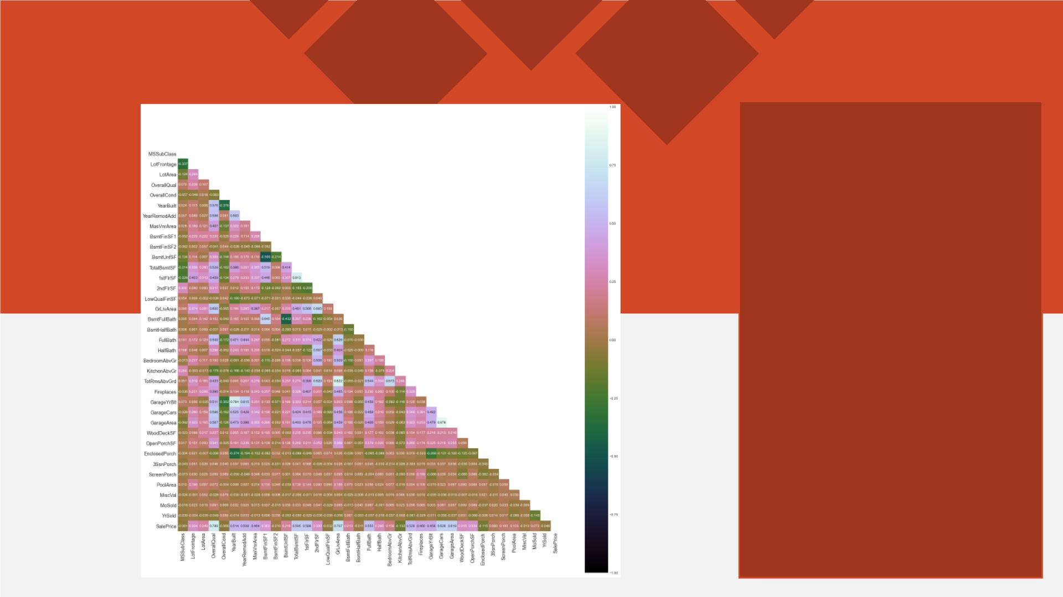
HEATMAP
A heatmap contains
values representing
various shades of the
same color for each
value to be plotted.
Usually the darker
shades of the chart
represent higher values
than the lighter shade.
For a very different value
a completely different
color can also be used.

Slide 19
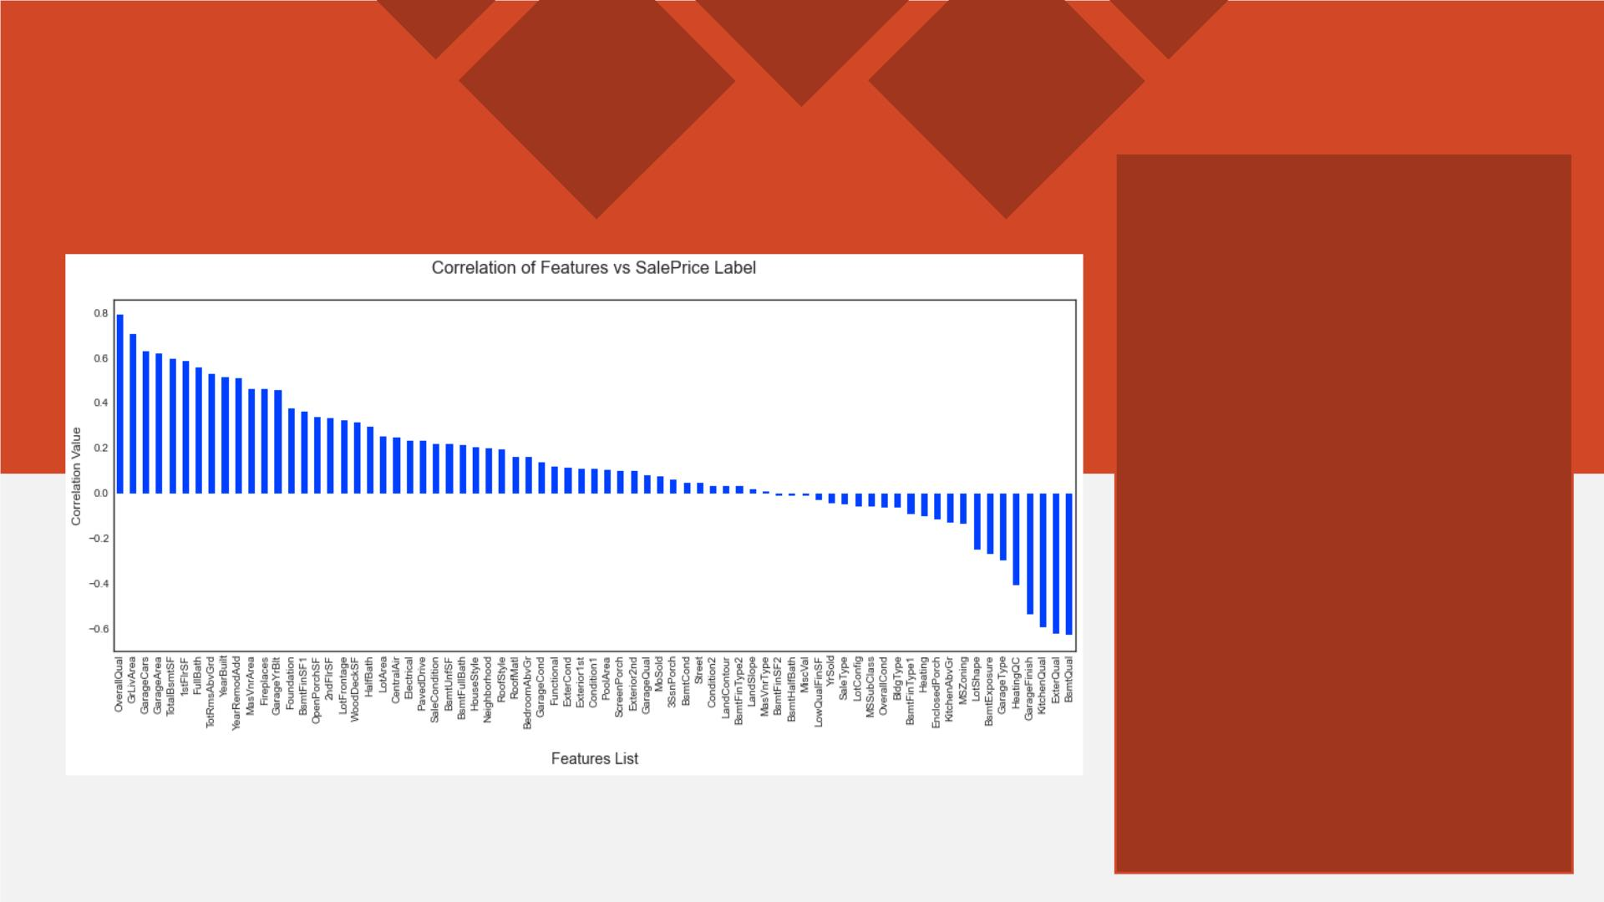
BAR GRAPH
Bar graphs are used to
compare things
between different
groups or to track
changes over time.
Here we are comparing
the correlation values
between the feature
columns and the target
label column which is
Sale Price in our
scenario.
It gives us an insight on
positive and negative
correlated column
details.

Slide 20
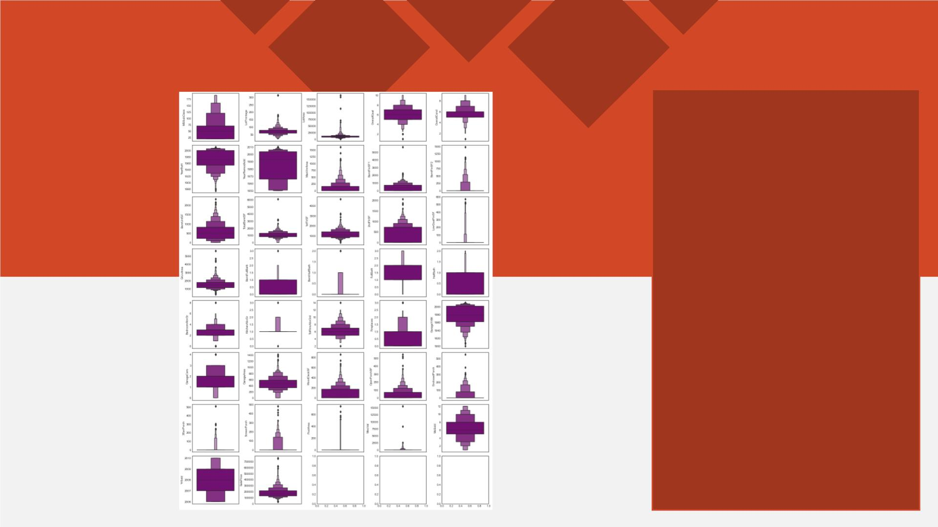
BOXEN PLOT
A Boxen Plot is also
known as Whisker plot is
created to display the
summary of the set of
data values having
properties like minimum,
first quartile, median,
third quartile and
maximum.
We have used it to
identify the outlier
details for all the
numeric datatype
column values.

Slide 21
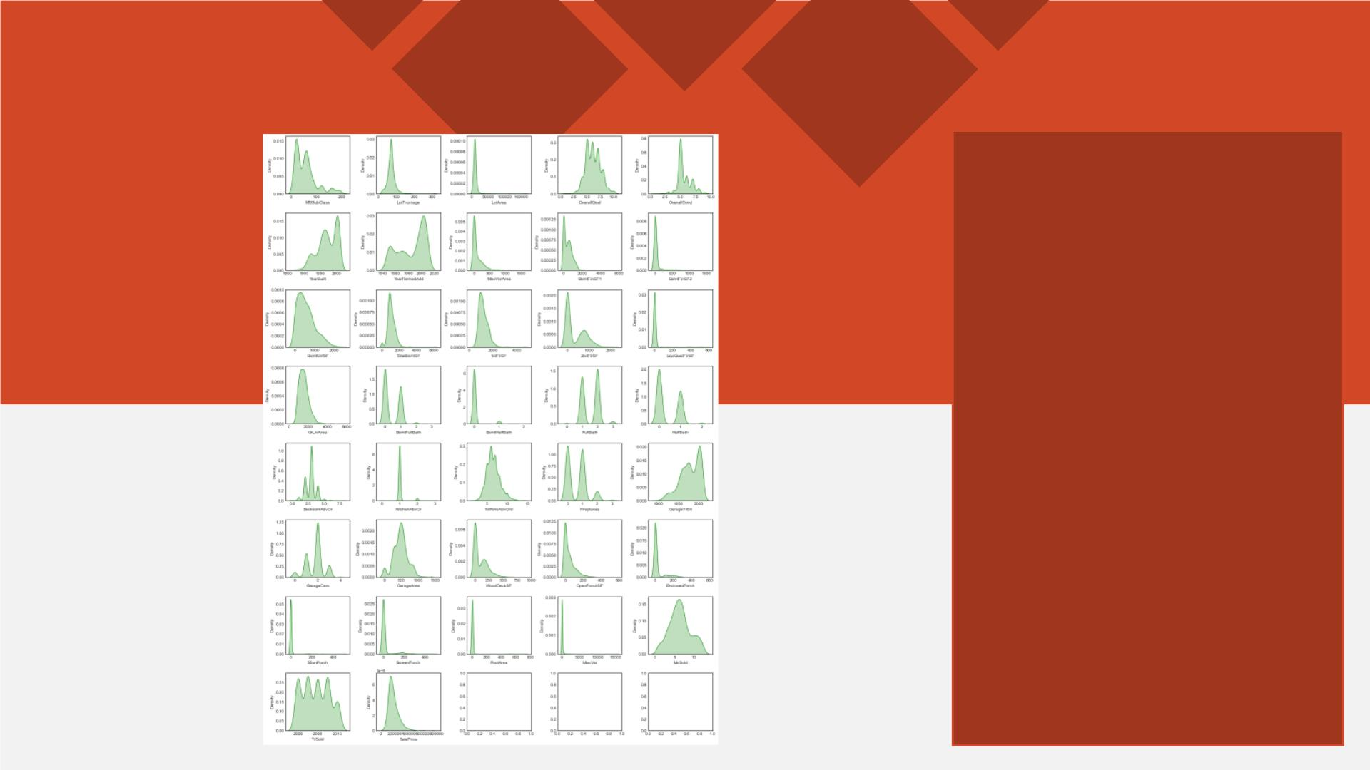
DISTRIBUTION PLOT
Distribution plots visually
assess the distribution of
sample data by
comparing the empirical
distribution of the data
with the theoretical values
expected from a
specified distribution.
Here we have used it to
analyze the skewness
information for numeric
datatype column values.
The acceptable form
usually is a normal
distribution resembling a
bell shape curve.

Slide 22
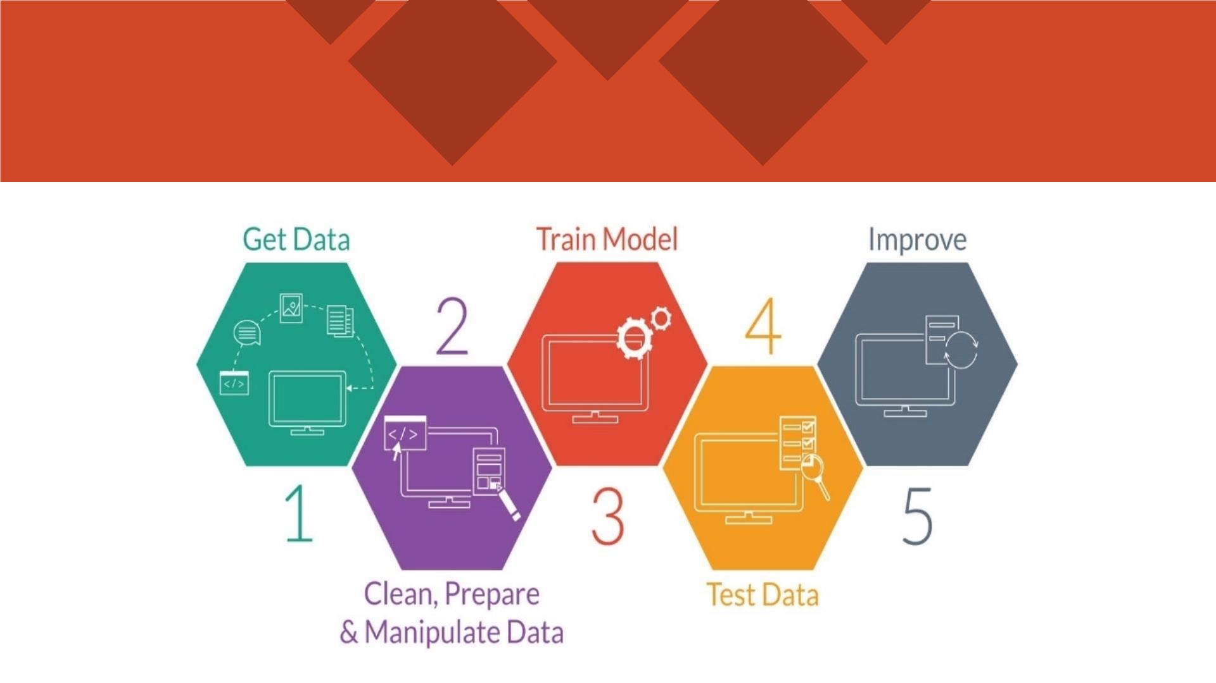
MODEL TRAINING PHASES

Slide 23
MODEL/S DEVELOPMENT
The algorithms used on training and test data are as
follows:
1. Linear Regression Model
2. Ridge Regularization Regression Model
3. Lasso Regularization Regression Model
4. Support Vector Regression Model
5. Decision Tree Regression Model
6. Random Forest Regression Model
7. K Nearest Neighbors Regression Model
8. Gradient Boosting Regression Model
9. Ada Boost Regression Model
10.Extra Trees Regression Model

Slide 24
EVALUATION AND HYPER PARAMETER TUNING
The key metrics used here were:
q R2 score
q Cross Validation Score
q MAE
q MSE
q RMSE
We tried to find out the best parameters list to increase our
accuracy scores by using Hyperparameter Tuning.
In order to achieve a higher score we used the Grid Search CV
method with 5 folds.

Slide 25
CONCLUSION AND SCOPE FOR FUTURE
WORK
q During this project I have faced a problem of low amount of
data for training the machine learning models upon.
q Many columns are with same entries in more than 80% of rows
which lead to reduction in our model performance.
q One more issue present is there are large number of missing
values in this data set, so we have to fill those missing values in
correct manner manually.
q We can still improve our model accuracy with some feature
engineering and by doing some extensive hyperparameter
tuning on it.

Slide 26


